Slide 1
Enrichment, Pathways and Network Analysis
Mariam Quiñones, PhD

Slide 2

Today’s Instructor
Bioinformatics and Computational Biosciences Branch (BCBB), NIAID
National Institutes of Health, Bethesda, MD USA.
Contact our team via email:
Email: ace@icermali.org
Listserv: ACE-GLOBAL-ANNOUNCE@list.nih.gov
Instructor: mariam.quinones@nih.gov
Dr. Mariam Quiñones,
Ph.D. in Molecular Microbiology
Ongoing Computational Biology projects:
16S microbiome
Ion Torrent Zika virus genome assembly

Slide 3
Overview
Introduction to pathways, enrichment methods and networks
Pathways, ORA, GSEA
Theory on Gene Ontology
Networks analysis
Useful databases/tools for pathways and networks analyses
Overview of web network/pathway tools such as KEGG, Reactome, String, DAVID
Explore String networks
Practical
Run a Gene Set Enrichment using GSEA
Network visualization using Cytoscape

Slide 4
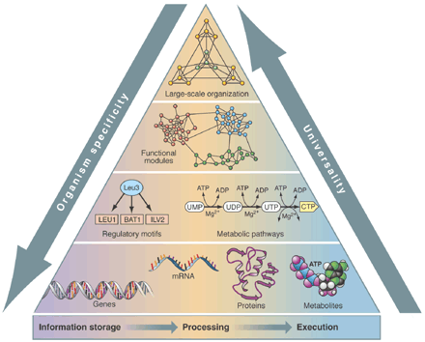
Biologists have abandoned the reductionist approach to adopt a systems biology approach to handle genome scale data
Genome Scale Data
Genome
Epigenome
Transcriptome
Proteome
Metabolome
Signalome
Pathways analysis is one component of a systems biology approach.
Science 2002 Oltvai et al., pp. 763 - 764
Notes:
Complex diseases are likely to be associated with the effects of multiple genes, proteins and biological pathways [1]. Pathway analysis methods that combine multiple types of high-throughput data, such as genomics and proteomics, have become the first choice to gain insights into the pathogenesis of complex diseases. A biological pathway that reduces data involving thousands of altered genes and proteins into a smaller and more interpretable set of altered processes and combines multiple types of high-throughput data plays an important role in understanding the mechanisms of complex diseases, improving clinical treatment, and discovering drug targets and biomarkers [2]. - https://bmcbioinformatics.biomedcentral.com/articles/10.1186/s12859-016-1333-x

Slide 5
Common methods for knowledge-base gene and pathways analyses
Enrichment: A gene set is tested for a significant association with a trait compared to an association of any other gene set (often the genes on a chip)
1- Over-representation analysis (ORA)
2- Functional Class Scoring (FCS)
3- Pathway Topology (PT)
Khatri P, PLOS 2012 http://www.ploscompbiol.org/article/info%3Adoi%2F10.1371%2Fjournal.pcbi.1002375
Holmans P, Advances in Genetics 2010 http://www.sciencedirect.com/science/article/pii/B9780123808622000072#
Zhang Q, BMC Bioinformatics 2016 https://bmcbioinformatics.biomedcentral.com/articles/10.1186/s12859-016-1333-x

Slide 6
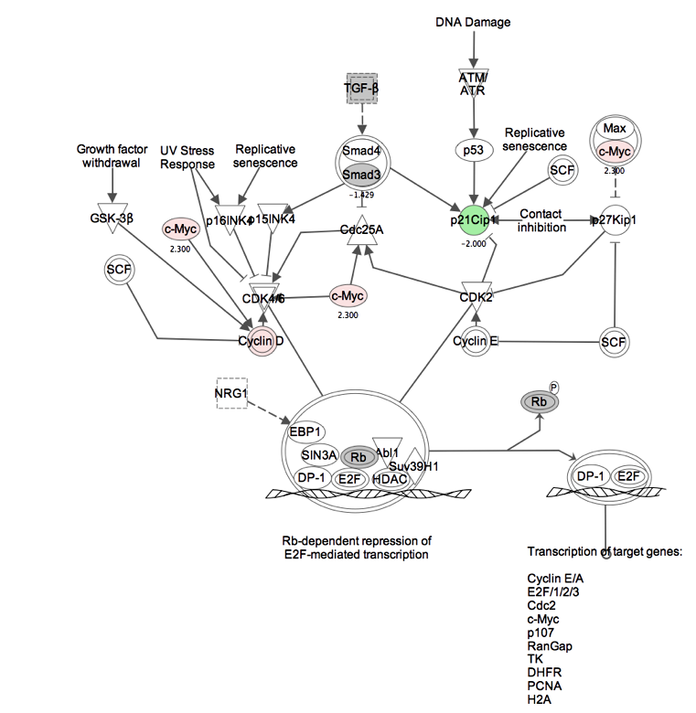
1- Over-representation analysis (ORA)
Before starting a pathway analysis, the researcher typically chooses genes that are differentially expressed in a given condition; these have an expression value and p-value
For each pathway, input genes in that pathway are counted. The process is repeated for a background gene set (e.g. the genes in the microarray chip)
Pathways are tested for over-representation in the list of input genes. If the proportion of genes in the pathway appearing on the list is significantly higher than the corresponding proportion of genes not in the pathway, the pathway is said to be overrepresented.

Slide 7
1- Over-representation analysis (ORA) - cont
Tools using ORA: DAVID, MetaCore, GeneGo, IPA
Statistical tests: Fisher's exact test, the hypergeometric distribution, or a chi-square analysis
Limitations: Gene IDs are the only requirement, gene expression levels are not used to provide weight. An arbitrary threshold cutoff is required to create the input gene list.

Slide 8
2- Functional Class Scoring (FCS) or Gene-set enrichment
It expects that small coordinated changes in related genes within the same pathway can cause significant effects
The FCS uses all genes. It computes differential expression of genes, aggregates all gene level statistics into pathway level statistic, and then determines the statistical significance of the pathway-level statistic.
Limitations: Some pathways cross and overlap, therefore a pathway may appear affected due to overlapping genes.
Tools: GSEA, sigPathway (BioConductor)
Notes:
Gene Set Enrichment Analysis (GSEA) method (13), the following steps are applied: (i) all genes are ranked by using a signal-to-noise ratio; (ii) for each gene set, the distribution of gene ranks from the gene set is compared against the distribution for the rest of the genes by using the enrichment score (ES) based on a one-sided Kolmogorov-Smirnov statistic; (iii) class labels are permuted to generate a null distribution of ES; and (iv) statistical significance of the observed score is assessed for the top-ranking gene set by comparison with the null distribution of maximum scores from each permutation. By considering the distribution of the gene ranks belonging to each gene set over the entire list, this method is a clear improvement over previous ones. However, the effect of the gene-set size and the influence of other gene sets not under consideration can be counterintuitive in some instances (14). Its normalization and permutation procedures also may lead to inaccurate assessment of statistical significance. – comment in http://www.pnas.org/content/102/38/13544 (sigPathway paper)

Slide 9
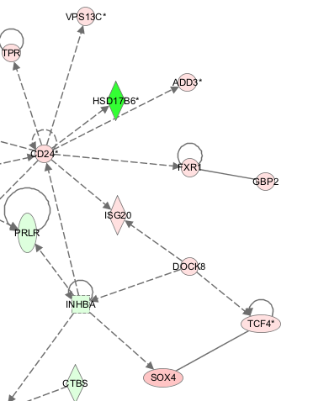
3- Pathway Topology or Network based
This method uses FCS but also use pathway topology to compute gene-level statistics.
It takes into account the number of reactions needed to connect two genes in a pathway.
It could incorporate biological factors such as gene expression, types of interactions and positions of genes in a pathway.

Slide 10
Why pathways analysis?
Pathways analyses
It is the analyses of sets of genes that are related to each other biologically. It helps interpret the data in the context of diseases, biological processes, pathways and networks.
High-throughput experimental technologies often identify hundreds of genes but do not necessarily produce biological findings.
Genes do not work alone but in a large network of interactions
An associated pathway is likely to implicate function better than a hit in a single gene

Slide 11
General limitations of Pathways Analysis methods
Incomplete annotation of genes and isoforms
Missing cell type specific information
Inability to understand pathway dynamics and how one pathway affects another one

Slide 12
Pathway Databases and tools
Some commercial tools:
Manually curated database:
Ingenuity Pathways http://ingenuity.com/
GeneGo Metacore http://www.genego.com/
Text processing:
Pathway Studio
https://www.elsevier.com/solutions/pathway-studio-biological-research

Slide 13
Web and open source pathways databases and tools
Comprehensive Databases for Pathways:
KEGG http://www.genome.jp/kegg/pathway.html
WikiPathways http://www.wikipathways.org
Reactome http://www.reactome.org/
Pathway Commons http://www.pathwaycommons.org/pc2/
MSigDB- http://www.broadinstitute.org/gsea/msigdb/index.jsp
Selected Tools for enrichment and pathways analysis:
DAVID Bioinformatics http://david.abcc.ncifcrf.gov:8080/
g:Profiler http://biit.cs.ut.ee/gprofiler/
Gene Ontology enrichment http://geneontology.org/page/go-enrichment-analysis
ConsensusPathDB http://cpdb.molgen.mpg.de
Enrichr http://amp.pharm.mssm.edu/Enrichr/
Notes:
Also http://www.genmapp.org/go_elite/

Slide 14
Gene Ontology (geneontology.org)
Bioinformatics initiative with the aim of standardizing the representation of gene and gene product attributes across species and databases.
GO describes how gene products behave in a cellular context. It consists of three controlled vocabularies:
Molecular function (what does the gene product do?)
Biological process (why does it perform the activity?)
Cellular component (where does it act?)
It is very general and is available for a large number of organisms (>40 species).

Slide 15
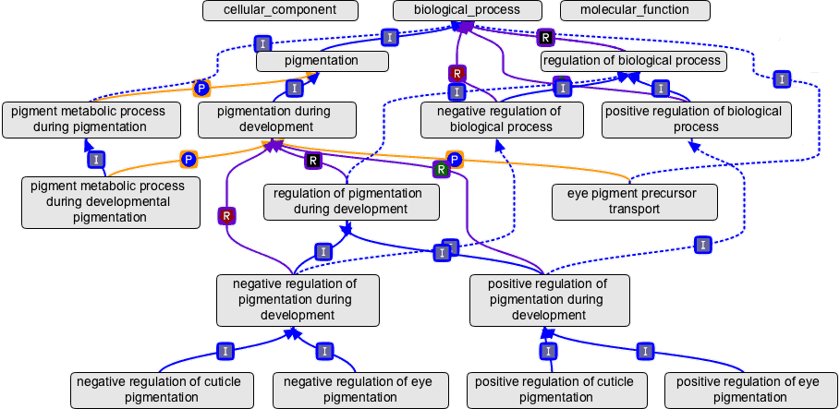
•In the Gene Ontology, each term is linked by the relationships “is a”, “part of” or “regulates”.
Annotating genes with GO terms allows sharing of gene information by facilitating queries. Searching is possible by GO Terms or GO IDs

Slide 16
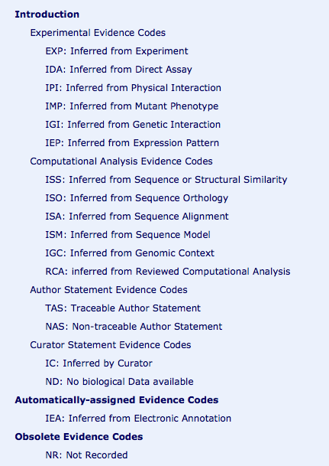
Gene Ontology
1- It infers classification from experimental data and electronic annotation
2- It labels the terms with an evidence code to record the type of evidence used to make the annotation

Slide 17

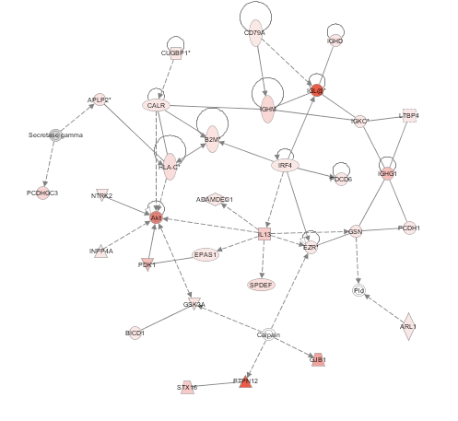
In addition to Gene Ontology and Pathways, let’s explore Networks
Pathway
Network
- Could inform you of key molecules “hubs”
Could provide information on possible link between two affected pathways not present in your dataset
It has directionality
Triangular relationships
Curated in the literature
De Novo and unbiased
Notes:
Curated in the literature

Slide 18
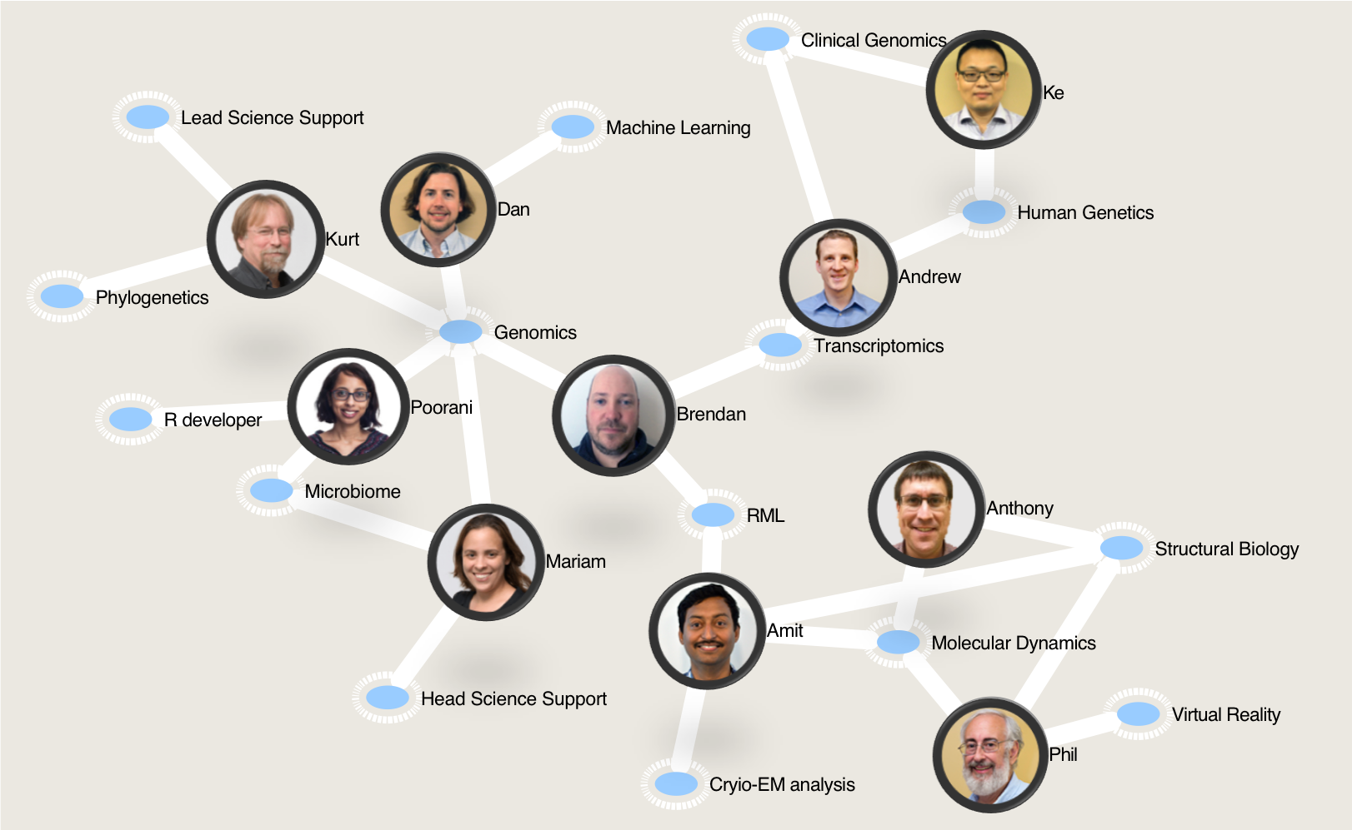
Networks
Example of network types:
Social (Facebook)
Professional (LinkedIn)
Biological (PPI)
Purpose of networks
Study interactions
Infer function based on association
Edge
Node

Slide 19
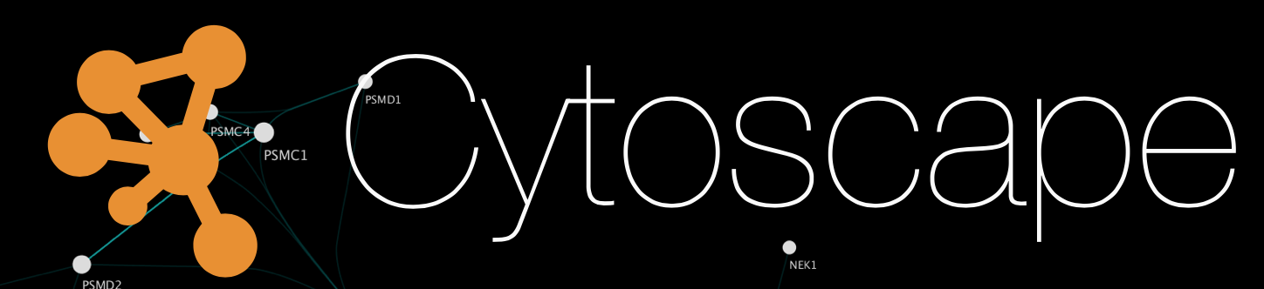

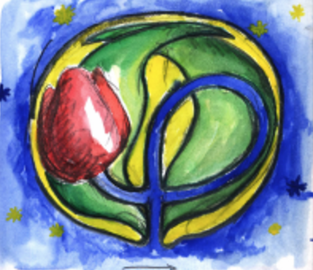
Software to create and analyze networks
http://cytoscape.org
Best at biological visualization
https://gephi.org
Best at general visualization
http://tulip.labri.fr/
Easy to use
Tulip

Slide 20
Networks use data from Protein-protein or Protein-DNA interaction databases
BioGRID – (The Biological General Repository for Interaction Datasets) – a curated database http://www.thebiogrid.org/
IntAct – EMBL molecular interaction database http://www.ebi.ac.uk/intact/
Pathways Commons http://www.pathwaycommons.org/pc/ - Integrates data from BioGRID, HumanCyc, IntAct, Reactome, MINT, NCI, SBCNY, HPRD and CancerCell Map. Important: Of these sources, IntAct and MINT contain data for some parasites.
STRING http://string.embl.de/ and GeneMania http://genemania.org
Combines known and predicted protein-protein interactions
Predictions are derived from Genomic context, high throughput experiments, co-expression and previous knowledge reported in PubMed.

Slide 21
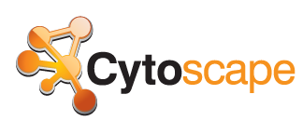
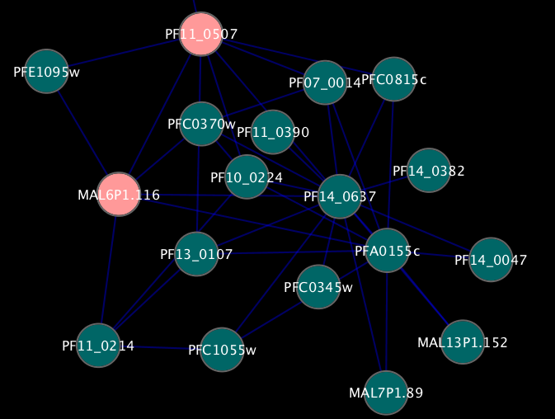
www.cytoscape.org
Open source visualization tool for networks
Framework; functionality is expanded with plugins
It allows users to:
Modify networks to ease of visualization
Load custom datafiles or files from databases such as Pathways Commons
Explore large networks

Slide 22
Cytoscape has a library of plugins to perform enrichment and network analysis
Example: ClueGo plugin

Slide 23
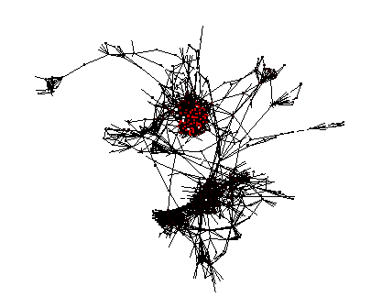
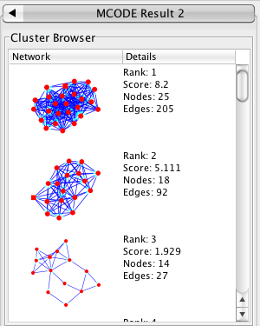
Other plugins to analyze networks include MCODE
Identifies densely connected areas of protein interaction networks
MCODE (Molecular Complex Detection) v1.2 (Jan 2007) A Cytoscape PlugIn Version 1.2 by Vuk Pavlovic (Bader Lab, University of Toronto)
Bader GD, Hogue CW An automated method for finding molecular complexes in large protein interaction networks. BMC Bioinformatics. 2003 Jan 13;4(1):2

Slide 24
Next: Practical Session
Exercise on enrichment, exploring interaction databases, visualizing and analyzing networks

